Slide 1
WHAT IS YOUR FAVORITE
PIZZA TOPPING?
Group 8B : Made Jessica Felicia, Fabian Cruz-Ruiz,
Yi-En Ivy Liu, Grace Kim, Chieh-Yi Chou
Notes:
Hello everyone! We are Group 8B, and I’m Grace Kim, here with Jessica, Fabian, Ivy, and Chieh-Yi.
I've only been in the U.S. for about a month, so I haven’t had the chance to try real American pizza yet—aside from Trader Joe’s frozen pizza.
But I’ve heard that pizza is a favorite here, and even one of my American friends says pizza is his go-to hangover cure! Since pizza is such a big part of American culture,
[Next Page] our group thought it would be fun to explore whether your pizza topping choice says something about your housing status, age, or maybe even your political views.

Slide 2
INTRODUCTION
Is there a significant relationship between a person's favorite pizza topping and their personal or lifestyle characteristic?
Notes:
Our group thought it would be fun to explore whether your pizza topping choice says something about your housing status, age, region or maybe even your political views. And if there’s any correlation, next time you're on a blind date at a pizza place, you might be able to figure out your date’s personality just by the toppings she or he orders!"
Ask the class to engage them : (Dont) Raise your hand if you think this true?
Blind date
Data collection resources: their age, income, marital status, education, employment status, educational background, political affiliation, and region?

Slide 3
TABLE OF CONTENTS
01
03
02
04
Data Resources
Variables
Region, Housing Status, Marriage Status, Employment Status, Age, Education, Income, Gender, Political Affiliation
Roper iPoll Center
Sample Size: 1018
January 2015 telephone Interview
Statistical Methods
Significant Findings
Marriage Status, Employment Status, Region, Gender, Education
Chi-Squared Test
Z-Test
Regression
Notes:
Here’s how we handled the data. First, we gathered it from the Roper iPoll Center, which surveyed over a thousand people by telephone in January 2015. Next, we applied several statistical methods we learned, including the Chi-Square Test, Z-Test, and Regression Analysis. Finally, we analyzed variables such as region, housing status, age, gender, education, and more to dig deeper into the pizza-loving population. Although we explored various variables, we found only a few significant findings related to marriage status, employment status, region, gender, and education. Fabian will share more insights on the next page with interesting graphs.

Slide 4
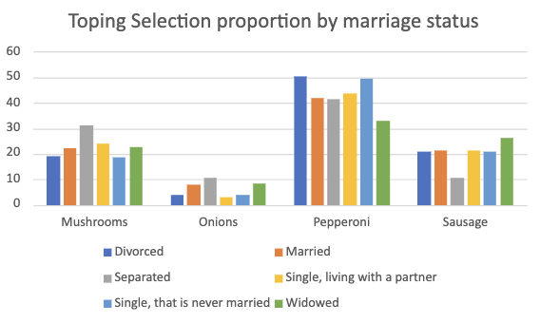

Slide 5
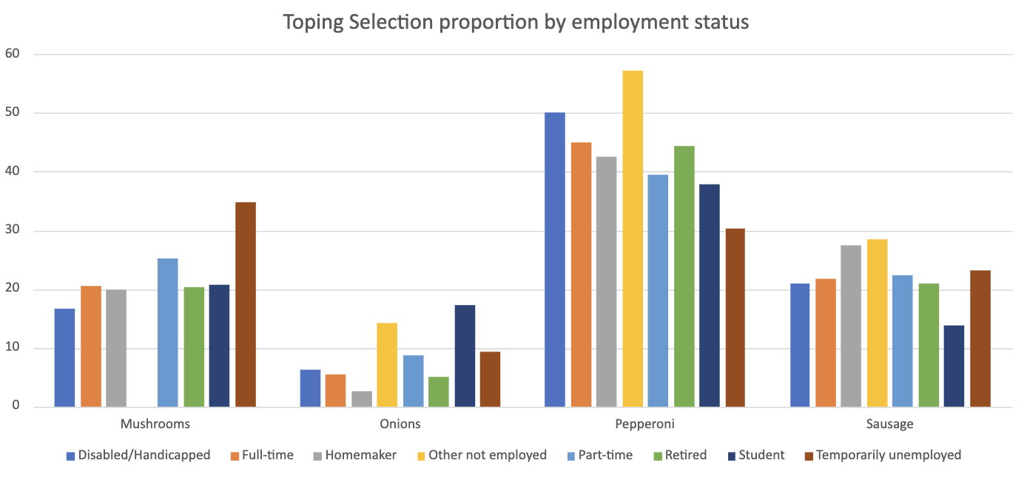

Slide 6
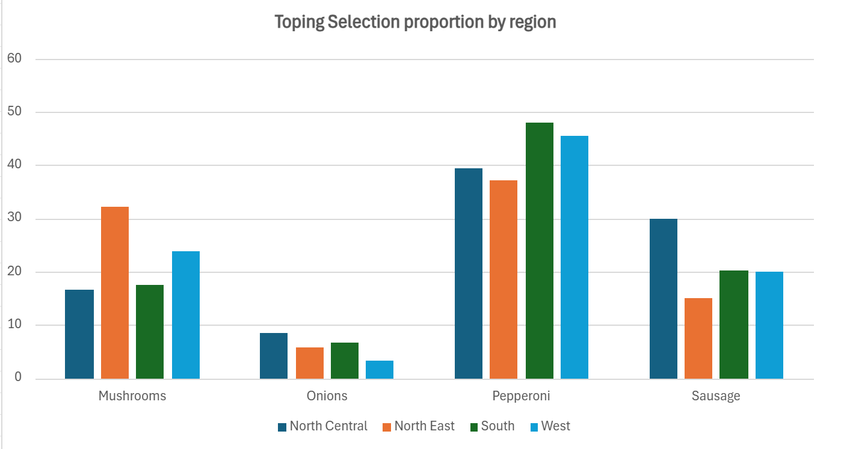
THIS IS A MAP
MARS
Despite being red, it’s cold
MERCURY
It’s the closest planet to the Sun
VENUS
Venus has a beautiful name

Slide 7
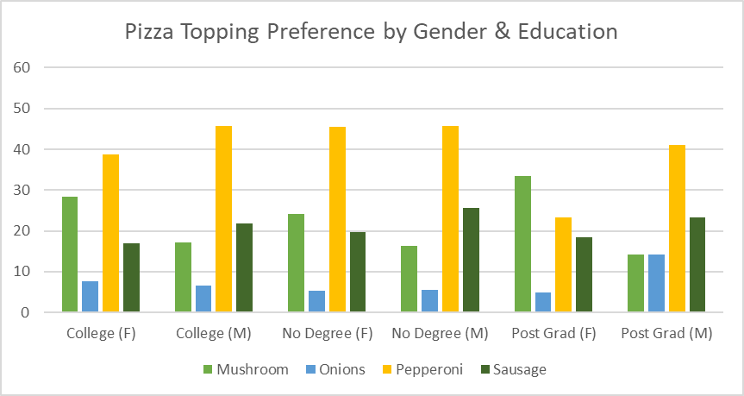

Slide 8
Conclusions
Divorced people prefers pepperoni than Widowed people
Widowed people prefers sausage than Separated people
Students prefers onions than Homemaker
North east prefers mushroom than any other region
North central prefers sausage compared to other region
Women prefers mushroom than male
Limitations
Old data samples (from the year of 2015)
More variation to the topping selections these days
Data relies on individuals who answered their phones
Insights
Marketing & advertising purposes
Notes:
Based on our analysis, here are some interesting conclusions:
Divorced people tend to prefer pepperoni more than widowed individuals while Widowed people prefer sausage compared to those who are separated.
Students seem to go for onions more than homemakers do.
The Northeast region prefers mushrooms over other toppings, while the North Central region leans toward sausage.
And, interestingly, females tend to prefer mushrooms more than males."
But of course, our study has its limitations. First, we’re working with data from 2015, and pizza preferences might have evolved since then. There could be more variety in topping choices now. Also, the data relies solely on individuals who answered their phones, which may not fully represent everyone’s preferences."
Nonetheless, this project was very meaningful for us, as it gave us a glimpse of how we can approach marketing strategies using the statistical tools we've learned in class
These days, with so many choices available, people often experience decision fatigue, especially when faced with an overwhelming number of menu options. As we worked on this project, we started thinking: if I were a franchise pizza owner, how could we simplify choices for customers by offering pre-made topping combinations that appeal to the majority? If we were Product Managers or Data Managers, we would use data-driven insights to determine the optimal menu.
As customization is a growing trend, identifying the most popular and optimal topping combinations could give businesses a competitive edge, this type of analysis can be applied broadly in food industries for marketing, and advertising strategies
I hope you found our topping analysis interesting and useful too. Thank you for listening

Slide 9

THANKS!

